Slide 1
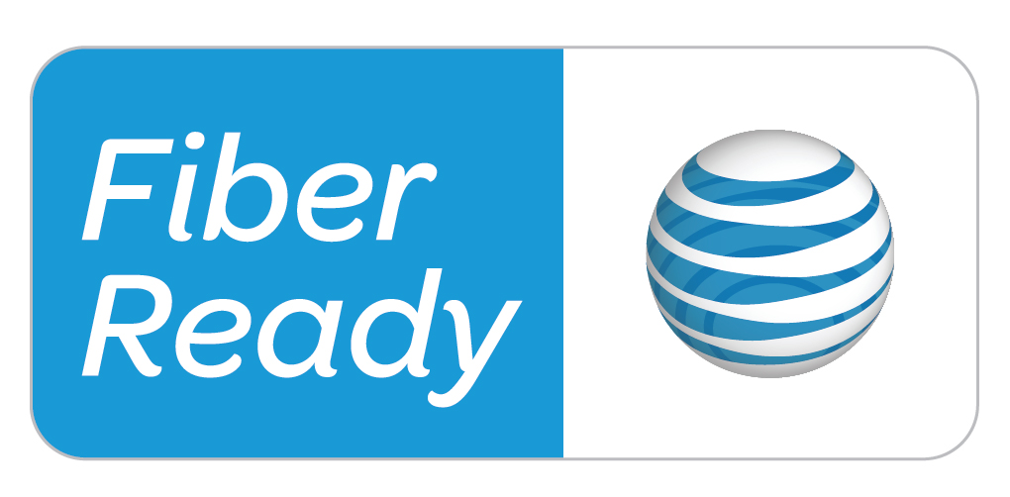
AT&T Fiber
--Connor Nelligan
--Kyle Broyles
--Corey Vest
--Blake Jackson

Slide 2
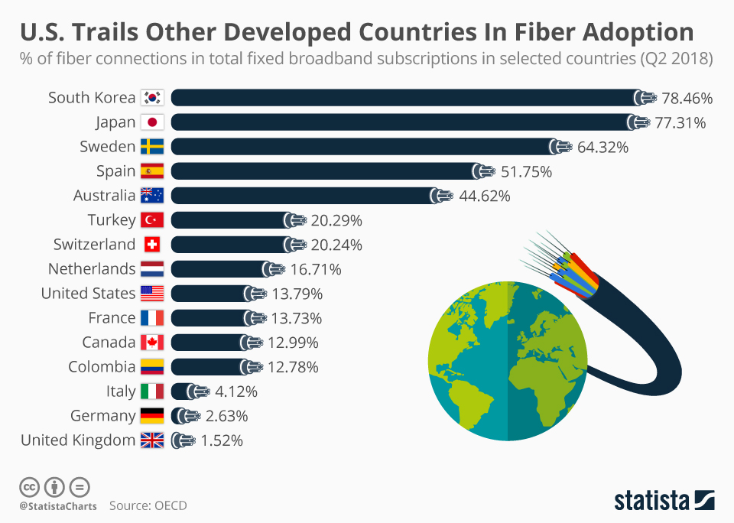
The US is behind other countries in terms of Fiber

Slide 3
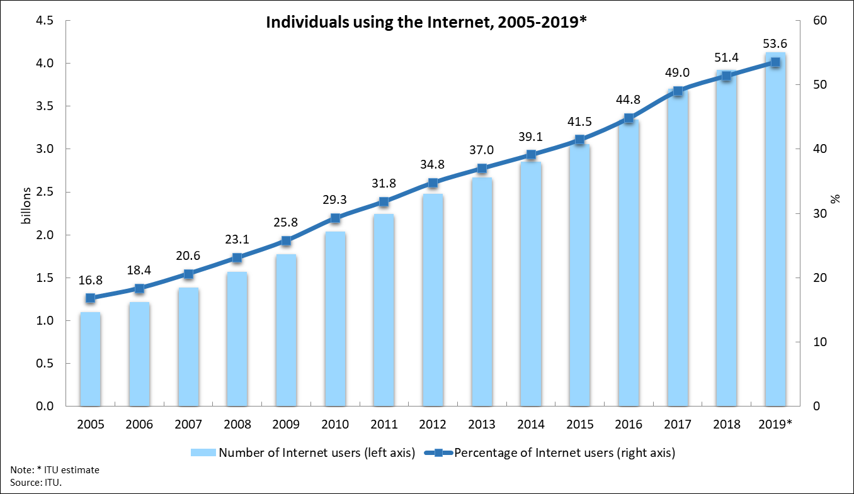
Our Proposal Meets the Needs of the Growing Population of Downtown Louisville

Slide 4
Our proposed location for Fiber is in downtown Louisville, zip code 40202
Currently Fiber is offered in parts of these cities listed:
Clarksville, Indiana
Jefferson County
Jeffersontown
Jeffersonville, Indiana
New Albany, Indiana
Shively
St. Mathews
Oldham County

Slide 5
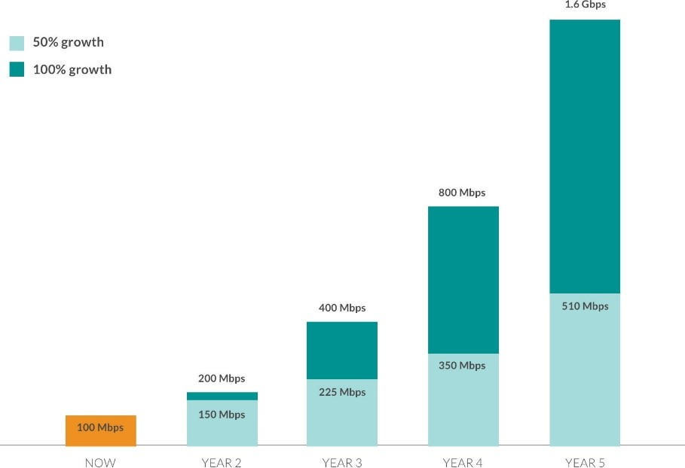
Speeds will continue to increase year over year, and our current internet providers are not doing what is necessary to keep up with the rapid pace of internet consumption.

Slide 6
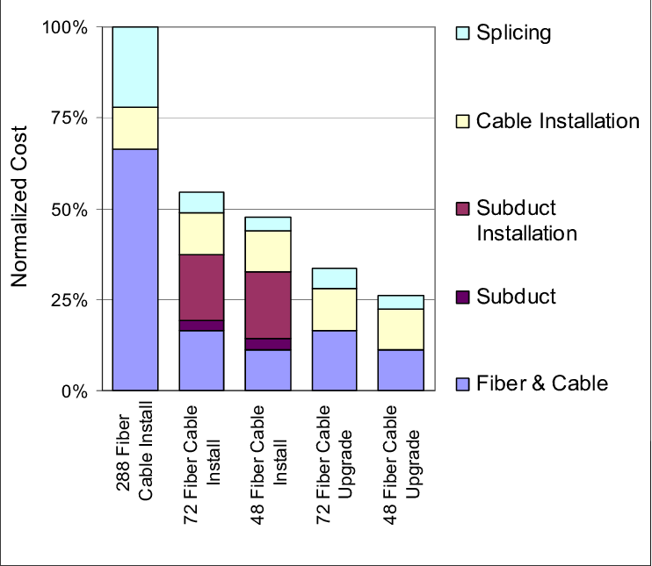
Cost
The Cost of Everything that goes into fiber Internet

Slide 7

Competition
There is currently no fiber optic business established in downtown Louisville.
AT&T is the largest provider of fiber networks.
AT&T has NOT installed fiber or in areas without pre established networks and other competitors.

Slide 8
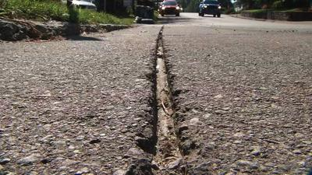
Competition
Google vs AT&T

Slide 9
Marketing
Target Market: Businesses located in downtown Louisville and Residents in the residing area
Marketing Objectives:
Monitor Downtown Louisville Internet usage to identify slowest areas
Approach Key Businesses
Address Concerns relating to installation
Increase community interest using Key Businesses as examples of the benefits

Slide 10
Marketing
Marketing Strategy:
By starting with Business leaders we can demonstrate to the community the benefits of using Fiber over Traditional Copper.
Speed
Reliability
Strength
Increased Bandwidth
By using some of the existing lines run before Fiber was abandoned originally we can minimize the property damage in the area and use those areas as some of the initial rollout

Slide 11
Thank You

